Slide 1
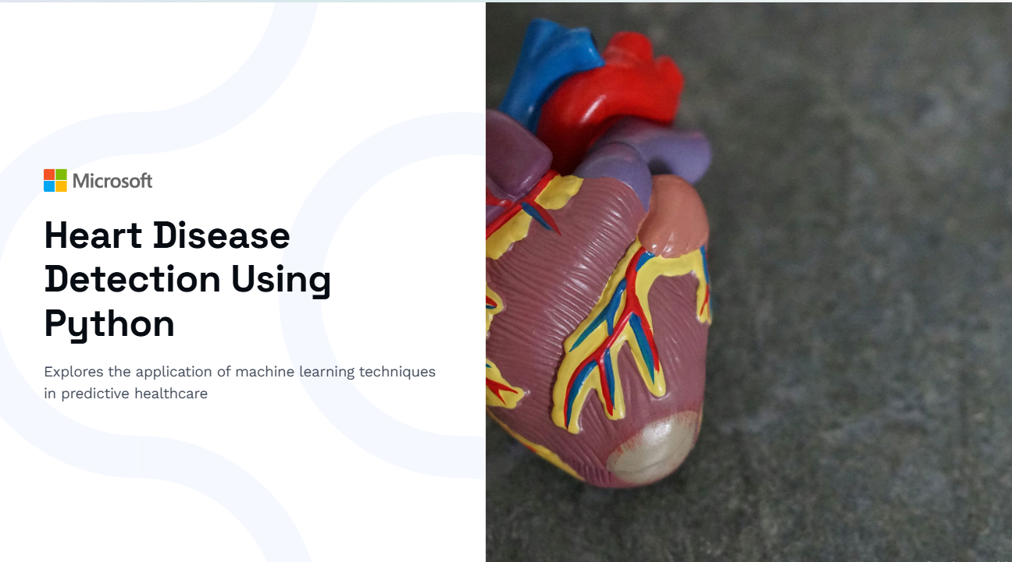
Devansh Goyal 500106363
Rishabh Sharma 500102032

Slide 2


Slide 3


Slide 4


Slide 5


Slide 6
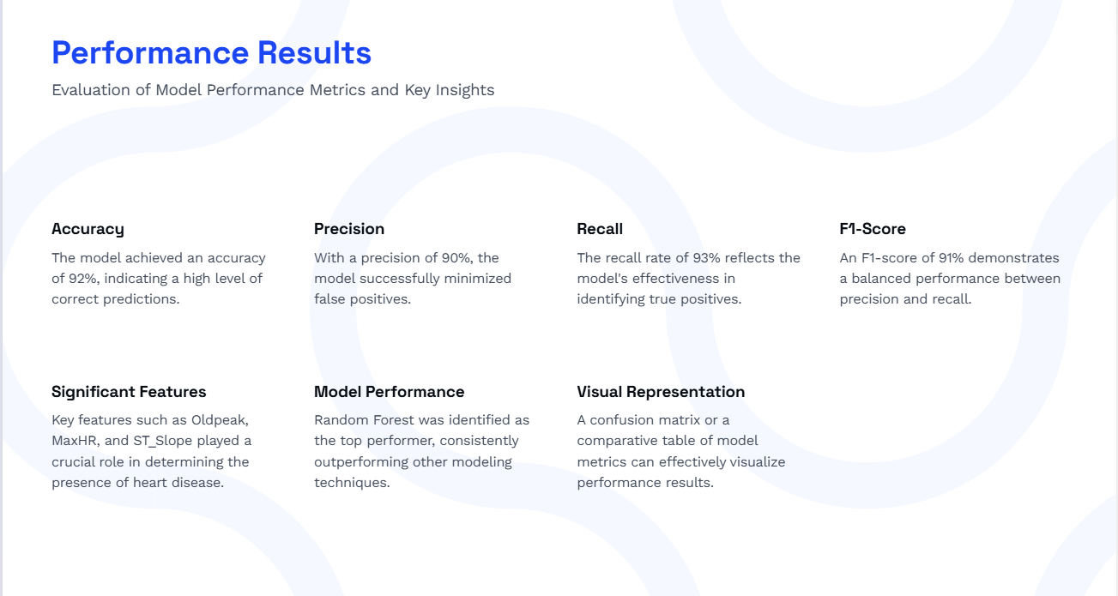

Slide 7


Slide 8

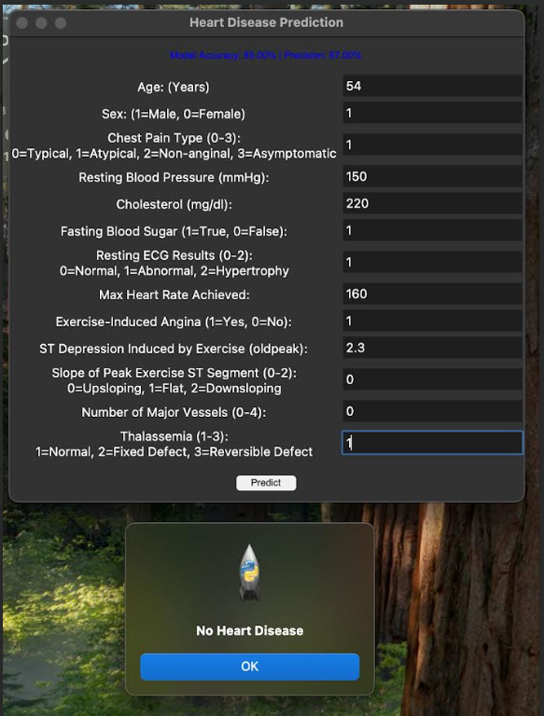

Slide 9
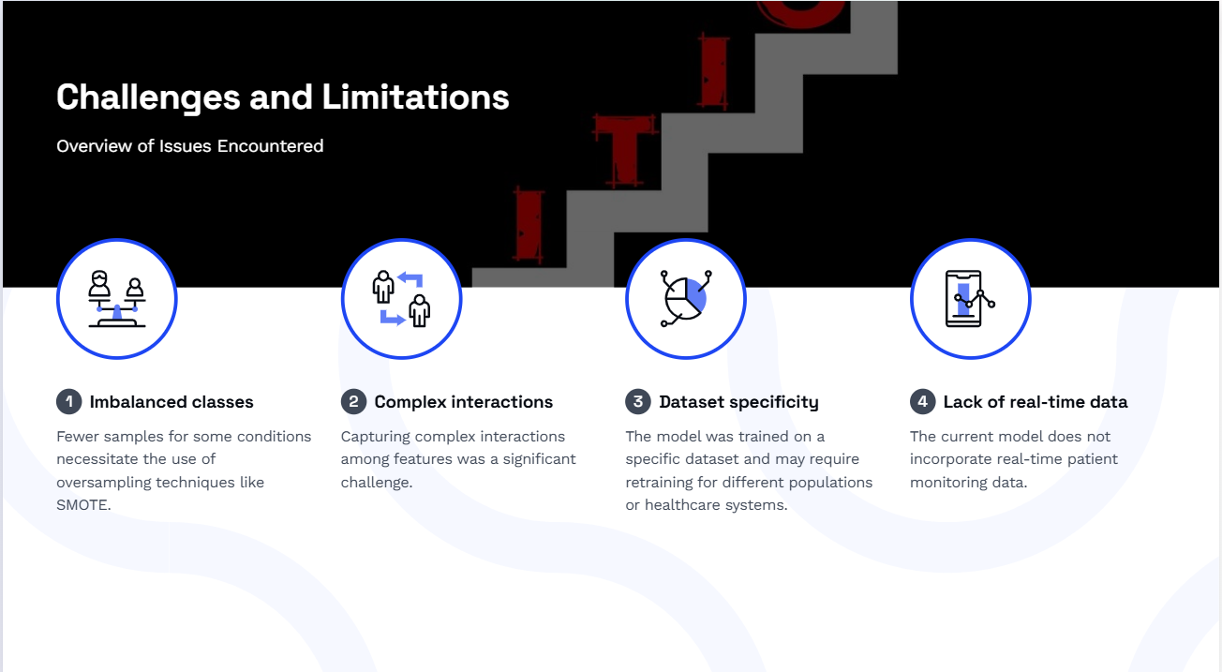

Slide 10


